Slide 1

Healthcare Management Analysis
Project Overview
This project is all about analyzing hospital billing and appointment records to uncover useful insights that can help improve hospital management and patient care. By using SQL, we process large amounts of data to track revenue, understand patient visit patterns, and identify trends that can optimize hospital operations.
What This Project Does:
Tracks hospital revenue
Examines patient appointment trends
Identifies top doctors and specializations
Monitors financial performance

Slide 2

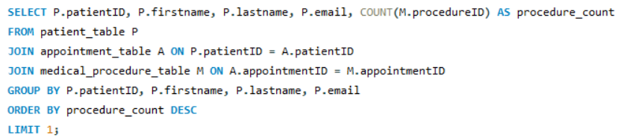

How many unique patients have scheduled appointments, and how many have never scheduled one?
Output:
Retrieve the full name and email of patients who have undergone the most medical procedures.
Output:

Slide 3
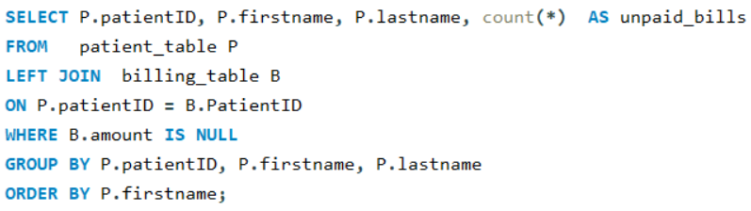
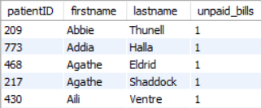
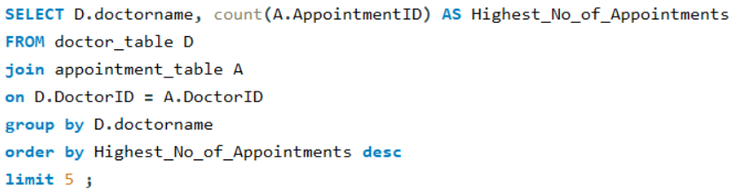
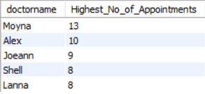
Identify patients who have multiple unpaid bills by checking for duplicate PatientID in the Billing dataset.
Output:
Find the top 5 doctors with the highest number of appointments scheduled.
Output:

Slide 4
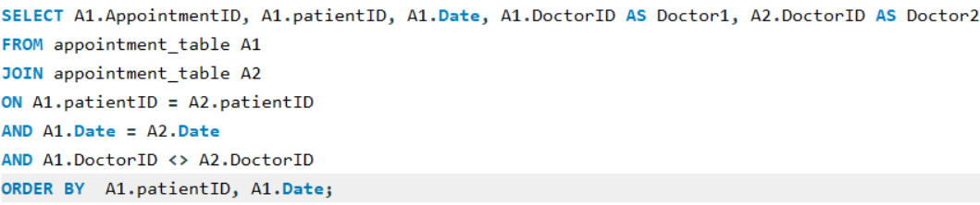

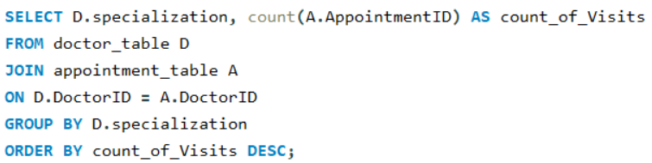

List all appointments where a patient has consulted more than one doctor on the same day.
Output:
Determine which specialization has the highest patient visit count based on appointment records.
Output:

Slide 5
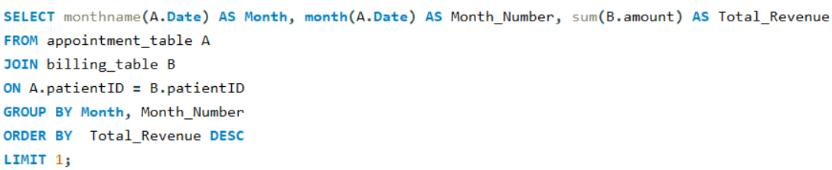

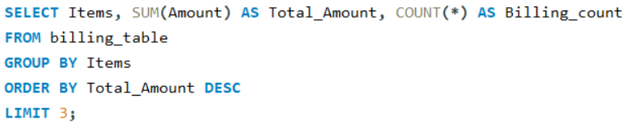

Calculate the total revenue generated from all patient bills, categorized by month and identify the "highest revenue-generating month."
Output:
Identify the top 3 highest billed items in the Billing table and count how many times each has been billed.
Output:

Slide 6
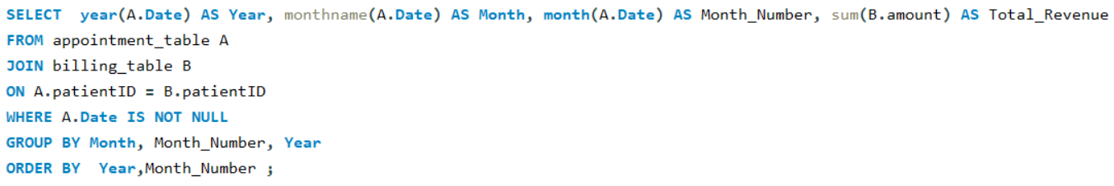
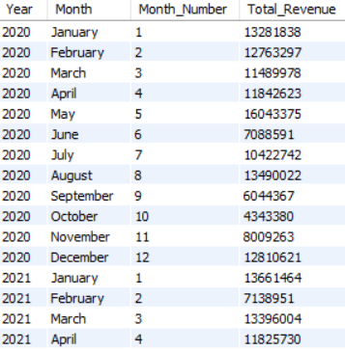
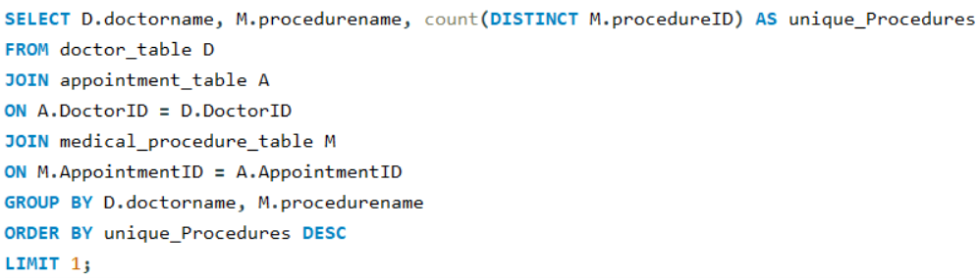

Generate a monthly revenue trend from medical billings to analyze financial performance.
Output:
Identify the doctor who has performed the highest number of unique medical procedures
Output:

Slide 7
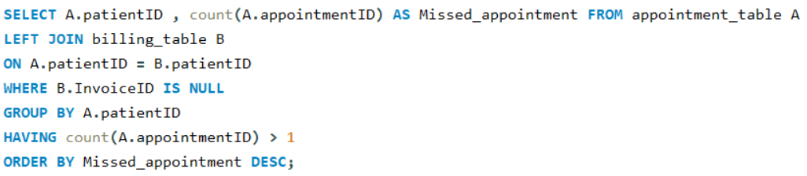
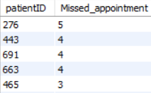
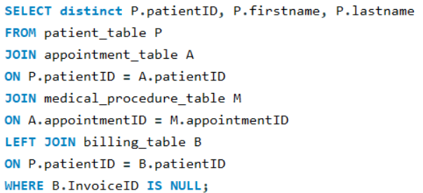
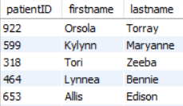
Identify patients who have frequently missed their appointments by checking duplicate PatientID values without corresponding billing records.
Output:
Retrieve a list of all patients who have undergone a procedure but have no billing record for it.
Output:

Slide 8
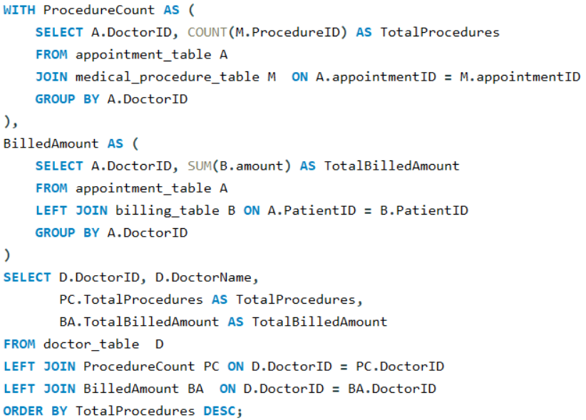
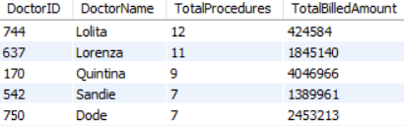
Generate a summary report showing the total number of procedures performed by each doctor along with their total billed amount.
Output:

Slide 9
Healthcare Management Analysis
Conclusion
This project helps us understand how hospitals can use data to improve their services. By analyzing appointments, bills, and patient visits, we found important insights like which doctors have the most patients, which months generate the most revenue, and which patients have unpaid bills.
Using SQL, we answered key questions that can help hospitals manage appointments better, track finances, and provide better patient care. This information allows healthcare providers to make smarter decisions and improve their services.
Overall, this project highlights the power of data-driven healthcare management, making it a valuable tool for hospitals looking to optimize their resources and improve service delivery.

